Slide 1
CS 580 – Discussion HW 2 Week 3
Matthias Hernandez

Slide 2


Note: error in provided pot4.ppm
Provided
Correct

Slide 3
Linear Expression Evaluation or scan-line?
LEE is simpler to implement
Scan-line examines fewer pixels
SECTION TITLE | 2

Slide 4
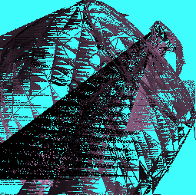


Possible issues with scanlines
Extra or missing horizontal/vertical lines are issues in the scan-line implementation
SECTION TITLE | 2

Slide 5
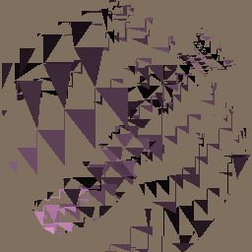
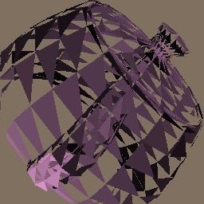
Possible issues with LEE
Missing triangles are due to not checking the LEE conditions properly
- All 3 LEE should have the same sign (>0 OR <0)
SECTION TITLE | 2

Slide 6
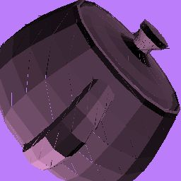
Possible issues with pixels falling on edges (both approaches)
If you see triangle lines: the pixels falling on edges are not properly handled:
- Pick left or right edges and include only one
- If the edge is horizontal: pick top or bottom edges and include only one
=> C code: You can use the ceil/floor commands
SECTION TITLE | 2

Slide 7
Z-buffering
- When to do Z-buffer checking?
Pixel-wise. Each time you write to pixel:
- Interpolate Z value at pixel (Zpix)
- Compare Zpix to the current Z-value in the Frame Buffer (Zfb)
- If Zpix < Zfb,
- override existing values for pixel: color/alpha/Z
- Otherwise,
- do nothing, skip pixel – the surface is occluded!
Note: Make sure you initialize the Z-buffer (to INT_MAX)!!
Note: You could do the Z-buffer checking in disp.cpp but it is better to have it in rend.cpp and keep the functionalities separate.
SECTION TITLE | 2

Slide 8
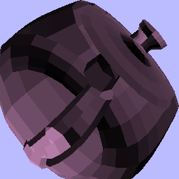

Possible issues with Z-buffering
Z-buffer not checked
Wrong Z-buffer test /
Wrong Z initialization (initial Z should be INT_MAX)
SECTION TITLE | 2

Slide 9
Other questions
Do we need to sort the triangles based on depth? No. The Z-buffer ensures the closest pixel will be drawn. The outcome is independent of the order of input triangles.

Slide 10
Other questions
Why do we use tokens and values?
It is generic and can handle any type of object. Otherwise, a separate function would be needed for each type of data. In HW2, we only use GZ_POSITION and GZ_RGB_COLOR, but more will appear in later HWs.
example:
GzColor color = (*(GzColor *)valueList[i]);

Slide 11
Other questions
How are the homeworks graded?
We run your code and grade the output. A result without appearant artefacts would be considered correct.
If there is nothing on the screen, the grade will be 0…
There will be regrading for HW1, 2 and 3 when submitting HW 4. There will not be re-grading for the other homeworks.

Slide 12
Q&A

